Slide 1

Gender Classification
Computer Vision Course
Andrei Paraschiv, An I Master AI
Notes:
1

Slide 2

Gender Classification
Project description
Technologies used
Identify Gender by the features in the face of humans
Dataset used – Images scraped from Wikipedia, gender labeled
Keras+Tensorflow, Python
Face detection using OpenCV
Training images (faces) cropped and resized to 96x96 px
Data split - 80 training - 20 test
50 epochs
Trained model tested on 35.000 images
Notes:
1

Slide 3
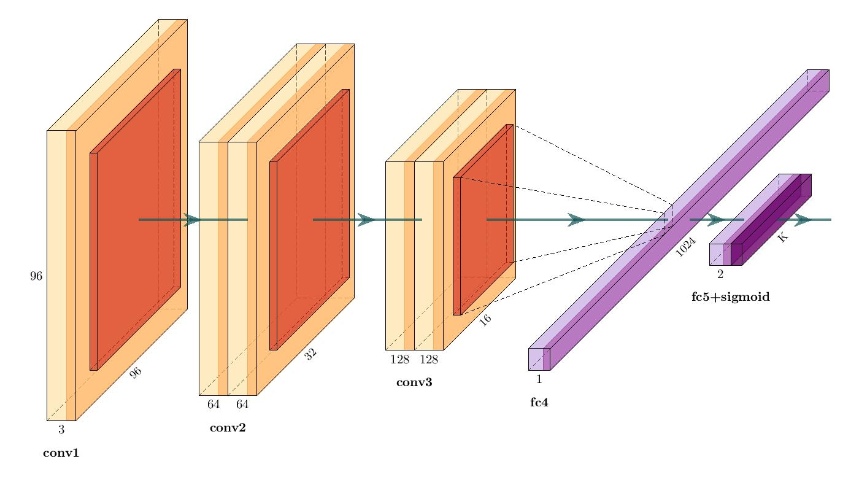
Simplified VGG
Conv 1 – one CNN, 32 filter/ 3x3 kernel
Conv 2 – two CNN, 64 filter/ 3x3 kernel
Conv 3 – two CNN, 128 filter/3x3 kernel
Fully Connected 1024
Sigmoid
Notes:
1

Slide 4
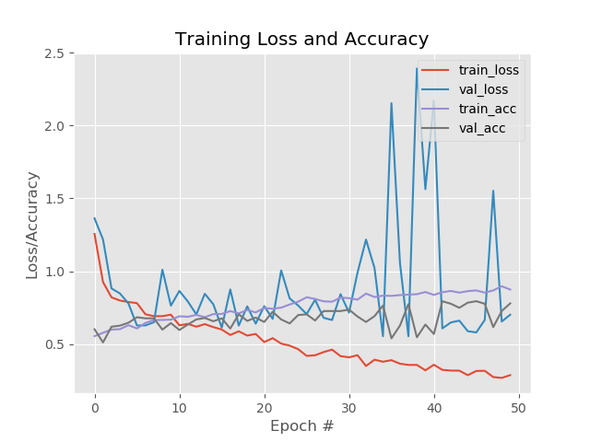

Experiment 1
1000
78 %
93 %
79 %
images
Accuracy
Precision
Recall
Sample misclassified images:
Notes:
1

Slide 5
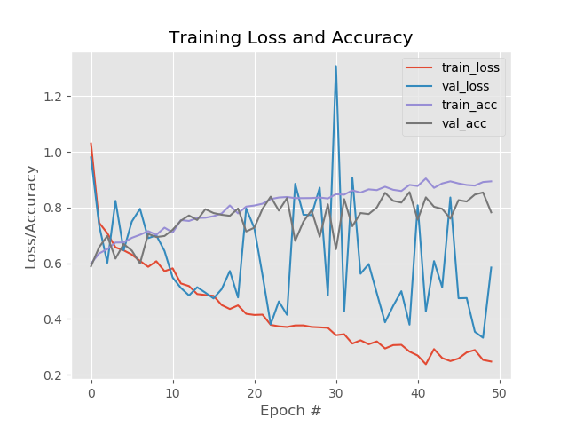
Experiment 1
2000
xx %
xx %
xx %
images
Accuracy
Precision
Recall
Sample misclassified images:
Notes:
1

Slide 6
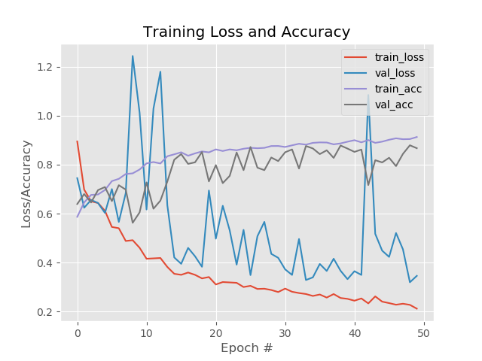
Experiment 1
5000
xx %
xx %
xx %
images
Accuracy
Precision
Recall
Sample misclassified images:
Notes:
1

Slide 7
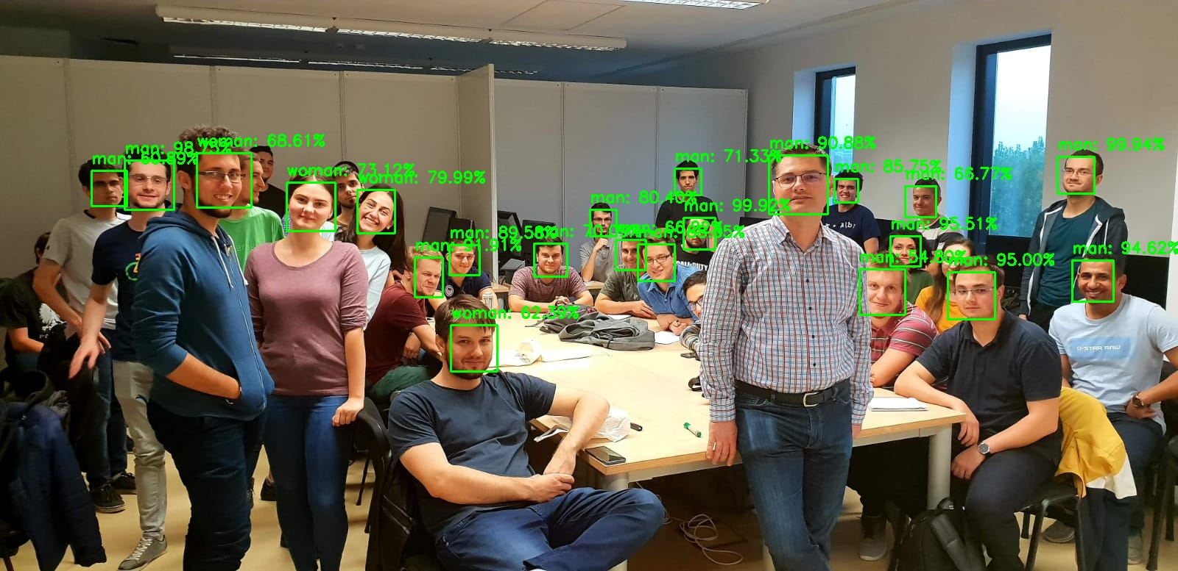
AAAAND… it’s working...
...in most cases :)
Notes:
1

Slide 8

Apologies to the missclassified
Notes:
1

Slide 9

¡HELLO!
JOHN SMITH AND KATY ANDERSON
Marketers must link the price to the real and perceived value of the product, but they also must take into account supply costs.
Notes:
1

Slide 10
“
SUCCESSFUL PEOPLE DO WHAT UNSUCCESSFUL PEOPLE ARE NOT WILLING TO DO. DON’T WISH IT WERE EASIER; WISH YOU WERE BETTER
”
Notes:
1

Slide 11
THIS IS A SLIDE TITLE
WRITE HERE YOUR TITLE
With this in mind, the marketing department would inform the department to create a prototype. Marketers must link the price to the real and perceived value of the product, but they also must take into account supply costs, seasonal discounts, and prices used by competitors. In some cases.
The production department would then start to manufacture the product, while the marketing department. Marketers must link the price to the real and perceived value of the product, but they also must take into account supply costs, seasonal discounts, and prices used by competitors. In some cases.
Additionally, a firm's finance department would be consulted. The marketing orientation is perhaps the most common orientation. Marketers must link the price to the real and perceived value of the product, but they also must take into account supply costs, seasonal discounts, and prices used by competitors. In some cases.
Notes:
1

Slide 12
BIG CONCEPT
With this in mind, the marketing department would.
Notes:
1

Slide 13
YOU CAN ALSO SPLIT YOUR CONTENT
PROJECT ONE
PROJECT ONE
With this in mind, the marketing department would inform the department to create a prototype. The production department would then start to manufacture the product, while the marketing department. With this in mind, the marketing department would inform the department to create a prototype. The production department would then start to manufacture the product, while the marketing department.
With this in mind, the marketing department would inform the department to create a prototype. The production department would then start to manufacture the product, while the marketing department. With this in mind, the marketing department would inform the department to create a prototype. The production department would then start to manufacture the product, while the marketing department.
Notes:
1

Slide 14
IN TWO OR THREE COLUMNS
PROJECT ONE
PROJECT TWO
PROJECT THREE
With this in mind, the marketing department would inform the department to create a prototype. The production department would then start to manufacture the product, while the marketing department. With this in mind, the marketing department would inform the department to create a prototype.
With this in mind, the marketing department would inform the department to create a prototype. The production department would then start to manufacture the product, while the marketing department. With this in mind, the marketing department would inform the department to create a prototype.
With this in mind, the marketing department would inform the department to create a prototype. The production department would then start to manufacture the product, while the marketing department. With this in mind, the marketing department would inform the department to create a prototype.
Notes:
1

Slide 15
WHAT BIG IMPACT? USE BIG IMAGE
Notes:
1

Slide 16
USE CHARTS TO EXPLAIN YOUR IDEAS
50%
70%
20%
Notes:
1

Slide 17
AND TABLES TO COMPARE DATA
PROJECT TITLE
ONE
TWO
THREE
FOUR
PROJECT ONE
100
30
2
4600
PROJECT TWO
40
1900
400
7
PROJECT THREE
500
300
1000
170
Notes:
1

Slide 18
PROJECT TWO
PROJECT ONE
PROJECT TWO
PROJECT FOUR
Notes:
1

Slide 19
THAT’S A BIG NUMBER
15,200,500,000
Notes:
<number>

Slide 20
$150,000
Unsuccessful people are not willing to do.
750,000 USERS
Unsuccessful people are not willing to do.
80%
Unsuccessful people are not willing to do.
Notes:
<number>

Slide 21
OUR PROCESS IS EASY
01
02
03
04
Notes:
<number>

Slide 22
LET’S REVIEW SOME CONCEPT
PROJECT ONE
PROJECT TWO
PROJECT TREE
Refers to a good or service being offered by a company. Ideally, a product should meet a certain consumer demand.
Refers to a good or service being offered by a company. Ideally, a product should meet a certain consumer demand.
Refers to a good or service being offered by a company. Ideally, a product should meet a certain consumer demand.
PROJECT FIVE
PROJECT SIX
PROJECT SEVEN
Refers to a good or service being offered by a company. Ideally, a product should meet a certain consumer demand.
Refers to a good or service being offered by a company. Ideally, a product should meet a certain consumer demand.
Refers to a good or service being offered by a company. Ideally, a product should meet a certain consumer demand.
Notes:
<number>

Slide 23
YOU CAN INSERT GRAPHS FROM GOOGLE SHEETS
TITLE ONE
TITLE TWO
TITLE THREE
Notes:
<number>

Slide 24

IPHONE MOCKUP
Some fifty years ago there was a curious case of whale trover litigated. Likewise a fish is technically fast when it bears a waif, or any other recognized symbol of possession. These are scientific commentaries; but the commentaries of the whale men themselves sometimes consist in hard words and harder knocks.
Notes:
<number>

Slide 25

IPAD MOCKUP
Some fifty years ago there was a curious case of whale trover litigated. Likewise a fish is technically fast when it bears a waif, or any other recognized symbol of possession. These are scientific commentaries; but the commentaries of the whale men themselves sometimes consist in hard words and harder knocks.
Notes:
<number>

Slide 26

MACBOOK MOCKUP
Some fifty years ago there was a curious case of whale trover litigated. Likewise a fish is technically fast when it bears a waif, or any other recognized symbol of possession. These are scientific commentaries; but the commentaries of the whale men themselves sometimes consist in hard words and harder knocks.
Notes:
<number>

Slide 27
THANK YOU…
CORPORATE PRESENTATION
Notes:
<number>

Slide 28
GENERAL

Slide 29
MEDICAL

Slide 30
DOWNLOAD MORE
GraphicPanda.net
Notes:
<number>

